Slide 1
Entrepreneurship
By: IHF
The European Commission’s support for the production of this publication does not constitute an endorsement of the contents, which reflect the views only of the authors, and the Commission cannot be held responsible for any use which may be made of the information contained therein.

Slide 2
Index
01
01
Project and Management
From what is a project to the POLC framework
02
02
Planning
What is planning, types of planning, why some managers fail to plan, effectiveness of planning, a practical example for a project
03
03
Organizing
What is, WBS, OBS, Gantt chart, Time management, list of tips for effective time management, Implication of poor time management, Team working, Team building
04
04
Leading
What is leading
05
05
Controlling
What is controlling

Slide 3
UNIT 1: Project and Management
Uniqueness
Limited
duration
What is a project?
A set of coordinated efforts in time (Kerzner, 1995)
A set of people and other resources temporarly assembled to reach a specific objective, normally with a fixed budget and with a fixed time period. Projects are generally associated with products or procedures that are being done for the first time or with procedures that are being altered (Graham, 1990)
A project can be defined as a temporary endeavor undertaken to create a unique product or service (Project Management Institute, A guide to the Project Management Body of Knowledge – PMBOK Guide)
An activity aimed at achieving a unitary objective over a certain period of time using a joint effort of a set of resources.
Constraints
Different
resources
Planning,
execution and control

Slide 4
Characteristics of project
A project is born thanks an impulse. There is a specific decision-making moment for the start-up.
Pursues an explicit objective determined by the customer
It is unique for:
the results to be achieved;
The mix of resources, skills to be used;
The context of reference
The degree of knowledge of the issue (problem?)
It is temporary
It is outside the scope of what can be achieved with the permanent structure
High interdependence of different disciplines/knowledge/resources is required
project implementation requires specific integration of different components of the existing organisational structure.
SCOPE
COST
TIME
Continuous trade off search
(The triangle shape is to underlying the continues trade-off)

Slide 5
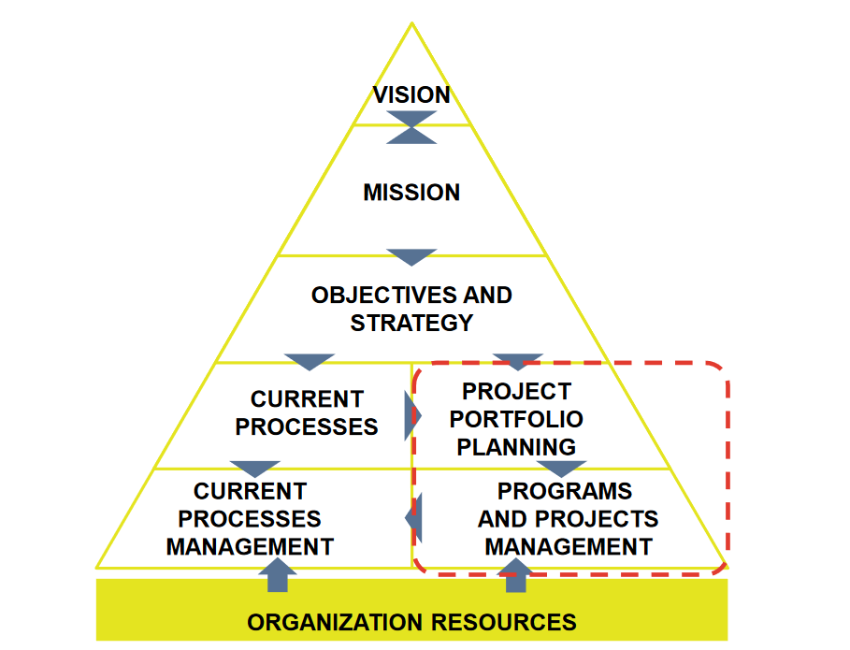
Where are the projects?
Key questions:
What is to be achieved?
When is it to be realised?
How much will it cost?
Who will carry out the realisation of the project?
What products or services will be produced as a result of the project activity?
How will project progress be measured?
Remember!
Rational organisational conditions:
the definition of objectives, professional skills, technical and instrumental resources, time and costs.
Source: Project Management and IT Projects, Guido Nicelli, Fodnazione Politecnico di Milano, Innovazione Digitale

Slide 6
So, how do you start?
IDENTIFY PROBLEMS/NEEDS
IDENTIFY OBJECTIVES
IDENTIFY OPTIONS
ESTIMATE OPTIONS AND BENEFITS
REVIEW THE ESTIMATION PROCESS
SELECT AND APPROVE FINAL OPTION
DEFINE DETAILED OBJECTIVES, CONTENTS AND APPROACHES
DEVELOP WBS
ESTABLISH COMMITMENT ON ACTIVITIES
DEFINE ORGANISATION
ALLOCATE RESOURCES AND PLAN WORK
ESTIMATE RISKS
FORMALISE PROJECT PLAN
1
PLANNING
2
INITIATION
WHERE DO WE WANT TO GO?
HOW ARE WE GOING TO GET THERE?
4
3
AGREEING DETAILED PLANS
AUTHORISE WORK
COORDINATE WORK
ASSESSING FINAL ACCOUNTS AND FORECASTS
ANALYSING PROGRESS
INITIATE CORRECTIVE ACTION
OPERATIONAL AND MANAGEMENT REPORTING
UPDATE WORK PLANS
CLOSE THE PROJECT
REVIEW OF PROJECT RESULTS
CLOSURE
EXECUTION
AND
CONTROL
HAVE WE ACHIEVED OUR GOALS?
WHAT CAN WE LEARN?
AT WORK!

Slide 7
Management
Management refers to the controlling and planning of details (Bauer 1998). By judicious use of available means the actual decisions are made and actions are carried out to achieve the objectives (Storey 1960).
Project Management: application of knowledge, skills, techniques and instruments to satisfy project requirements
Highlight critical situations and provide alternatives timely
Empowering all stakeholders on specific objectives
Provide realistic view of the project during its lifecycle
Draw a future evolution forecasting framework of the project
The process of managing a project from start to finish by allocating, utilising and monitoring (limited) resources in order to fulfil (project) requirements within a predefined time frame.
It is therefore necessary to:
Verify and resolve existing resource constraints and any conflicts that may arise
Align the strategic orientation of the organisation where this influences the achievement of the project objectives
Define shared governance

Slide 8
The P-O-L-C framework
A manager’s primary challenge is to solve problems creatively. While drawing from a variety of academic disciplines, and to help managers respond to the challenge of creative problem solving, principles of management have long been categorized into the four major functions of planning, organizing, leading, and controlling (the P-O-L-C framework).
Four crucial functions can be used to summarise management ideas. Planning, organising, leading, and controlling are these tasks. The P-O-L-C framework offers helpful direction for the optimal managerial position.
Planning | Organizing | Leading | Controlling
Vision & Mission Strategizing Goals & Objectives | Organization Design Culture Social Networks | Leadership Decision Making Communications Groups/Teams Motivation | Systems/Processes Strategic Human Resources

Slide 9
UNIT 2: a) Planning
Planning is the function of management that involves setting objectives and determining a course of action for achieving those objectives. Planning requires that managers be aware of environmental conditions facing their organization and forecast future conditions. It also requires that managers be good decision makers.
It is a procedure with a number of steps. The first step in the process is environmental scanning, which essentially implies that planners need to be aware of the significant risks to their business from the perspective of the economy, their rivals, and their clients. The next step is for planners to try to predict future conditions. Planning is based on these estimates.
Planning is considered a basic function of management. It means that a plan is necessary for any other managerial function, be it organising, directing, staffing, or controlling:
Planning dictates how to effectively organise a business. It encompasses determining necessary future activities, assigning them to the right personnel, delegating authority, providing tools and raw material, etc.;
Having a plan of action facilitates directing as it makes instructions, guidance and motivation grounded in a brand strategy;
Planning inform staffing, as it shows what work-force a company will need.
Establishment of standards and measurement of actual performance-controlling is done against the expectations that planning sets.

Slide 10
Types of planning
The first distinction we can make is between:
Informal planning gives a short-term focus, which might be necessary for the business to operate. In an organisation, various units can have their own informal plans.
However, if the company wants to grow and reach ambitious goals, the process of planning should be formal, written, specific, and involve common organisational goals.
We also have:
In order to position the organisation to compete successfully in its environment, strategic planning include analysing competitive possibilities and threats as well as the business's strengths and limitations. The duration of strategic planning is often three years or longer. Generally speaking, the entire organisation participates in strategic planning, which also involves setting goals. It frequently has as its foundation the organization's mission, which is the main reason for its existence. Strategic planning is typically carried out by an organization's senior management.
Tactical planning is intermediate-range (one to three years) planning that is designed to develop relatively concrete and specific means to implement the strategic plan. Middle-level managers often engage in tactical planning.
Operational planning generally assumes the existence of organization-wide or subunit goals and objectives and specifies ways to achieve them. Operational planning is short-range (less than a year) planning that is designed to develop specific action steps that support the strategic and tactical plans.

Slide 11
Why some managers fail to plan
Although planning is a basic function of management, in practice, many managers neglect it. You may think that they do not need formal types of planning, as they can use their strategic vision and gut instinct to keep the organisation on track even without it. However, this is not true. Here are the key reasons why managers fail to create a strategic plan:
They underestimate the importance of planning
They have too much reliance on their experience
Many managers adopt a get-things-done mentality, failing to pause and consider what they actually need to do. They are unwilling to make any changes since they do not comprehend how planning might impact performance.
Some managers may have achieved success without planning, leading them to believe that planning is pointless. Instead of favourable circumstances, they credit their own abilities with their accomplishment.
They lack time for planning
They lack self-discipline
It takes a lot of time to plan, and managers have too many duties. Managers frequently only consider strategic strategies while driving to work or at home as a result. This could lead to a lack of planning. Planning should be specifically scheduled by managers. If a manager finds it difficult to devote enough time to this position, they should assign extra tasks and refrain from micromanaging.
Setting and achieving objectives, whether they be personal or organisational, needs commitment and self-control. Managers frequently need to build their own talents and abilities in order to plan well.
They do not have the necessary knowledge
There are many tools used in planning such as SWOT analysis, PESTLE Analysis, VRIO Framework, environmental scanning, resource analysis, etc. If a manager didn’t get good training in management, he/she may fail to plan effectively and thus see no sense in it. It may also be that they lack experience in certain areas – creating a marketing plan is very different from operational planning.
They lack meaningful objectives and goals
Sometimes, managers avoid planning because there is no goal that will engage or motivate them to do so. This often happens with companies that operate without any mission statement.

Slide 12
Effectiveness of planning
If you understand the importance of planning in management and want to grasp all the benefits of this function, consider the following 5 factors that determine the effectiveness of planning.
Engagement | Despite the fact that planning is a managerial task, it shouldn't be carried out by a single individual in a closed room. Instead, a manager's job is to turn planning into a team effort that involves everyone. Make your staff feel involved in the planning process, and they'll be willing to commit to it and participate in the responsibility for seeing it through. They might even have creative suggestions that you would not have thought about.
Data, not assumptions | We all hold assumptions about businesses and markets, but they are not necessarily true. Basing your plan on assumptions is a grave mistake that overrides all the advantages of proper planning. It is important to do market research, host focus groups, talk to one’s own employees, consult market experts – gain any information that will help to base decisions on data rather than assumptions.
Communication | It is crucial to make the desired outcomes and the strategic strategy obvious to the staff. Encourage everyone to share opinions and make plan adjustments by fostering open communication. Keep in mind that some planning advantages, like creativity, depend on how ready people are to share their ideas and on whether they feel heard and valued for doing so.
Culture of growth | Only in a culture that prioritises efficiency and growth can a true emphasis on improving these metrics be sustained. Work to establish this kind of culture within your company. Employees will be more inclined to commit to ambitious goals and demanding plans if you support their learning and development, value and reward personal accomplishments.
Commitment to change | Effective planning requires letting go of outdated processes, revision of strategies, innovation, hiring and firing. All this means change, which is difficult to manage. Still, to truly benefit from the advantages of planning, a manager should be ready to go beyond the cosmetic changes and face the possible resentment of the team. In this respect, planning in management is a function that requires much courage and commitment.
It helps to set the right goals

Slide 13
A practical example for a project…
Project Plan
Tools
Project objective
Activities
Responsibilities
Timeframe
Budget
Monitoring and performance indicators
Risks
Project closure
WBS and OBS
Responsibility matrix
Network Diagram (CPM)
GANTT chart
Resource levelling
Crashing
Earned Value
Risk management

Slide 14
UNIT 3: b) Organizing
Organizing is the function of management that involves developing an organizational structure and allocating human resources to ensure the accomplishment of objectives. The structure of the organization is the framework within which effort is coordinated. The structure is usually represented by an organization chart, which provides a graphic representation of the chain of command within an organization. Decisions made about the structure of an organization are generally referred to as organizational design decisions.
Organizing involves both:
The design of individual jobs within the organization. Decisions must be made about the duties and responsibilities of individual jobs, as well as the manner in which the duties should be carried out. Decisions made about the nature of jobs within the organization are generally called “job design” decisions.
The design of organization level, deciding how best to departmentalize, or cluster, jobs into departments to coordinate effort effectively.
Recently, many organizations have attempted to strike a balance between the need for worker specialization and the need for workers to have jobs that entail variety and autonomy. Many jobs are now designed based on such principles as empowerment, job enrichment and teamwork.

Slide 15
WBS Work Breakdown Structure
A deliverable-oriented hierarchical decomposition of the work to be executed by the project team to accomplish the project objectives and create the required deliverables, with each level of the WBS representing an increasing detailed definition of the project work. It represents the fundamental structure for correlating and integrating different types of information: times, costs, responsibilities.
What is it?
a) Fully identify all aspects of the work
b) Assign responsibilities
c) Generate work plans at the various required scheduling levels
d) Generate estimates
e) Collect progress data
What it is used for?
A tool through which it is possible to:

Slide 16
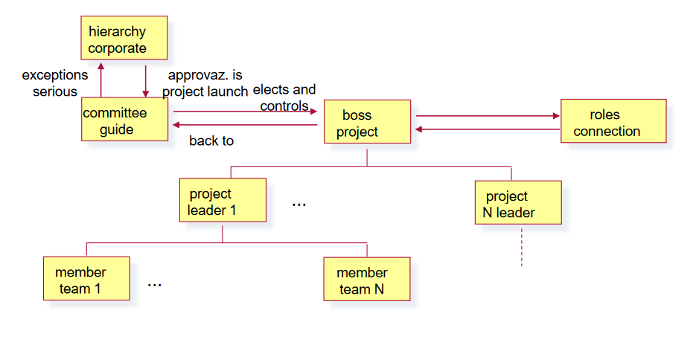
OBS, Organisational Breakdown Structure
The OBS represents the project organisational structure, the structured allocation of project responsibility levels; it serves to:
Identify and assign responsibilities;
Define and communicate the decision-making process;
Integrate time/cost information according to the defined responsibility structure.
A project OBS is a depiction of the project organization arranged to indicate the reporting relationship within the project context. The OBS reflects the way the project is functionally organized.
It is a direct representation and description of the hierarchy and organizations that will provide resources to plan and perform work identified in the WBS. The OBS helps management focus on establishing the most efficient organization, by taking into consideration availability and capability of management and technical staff.
Project Managers are responsible for the creation of an OBS for their assigned projects.

Slide 17
GANTT Chart
A Gantt chart is a commonly used graphical depiction of a project schedule. It is a type of bar chart showing the start and finish dates of a project’s elements such as resources, planning, and dependencies.
Key takeaways:
A Gantt chart is a visualization that helps in scheduling, managing, and monitoring specific tasks and resources in a project.
It consists of a list of tasks and bars depicting each task’s progress.
The horizontal bars of different lengths represent the project timeline, which can include task sequences, duration, and the start and end dates for each task. A Gantt chart can vary in complexity and depth, but will always have three key components: activities or tasks that are to be done, running along the y-axis; milestones or progress stages indicated along the x-axis (either on the top or bottom of the chart); and progress bars, denoted as horizontal bars, denoting how far along each task is at any given point.
It is the most widely used chart in project management.
Gantt charts can be used in managing projects of all sizes and types.

Slide 18
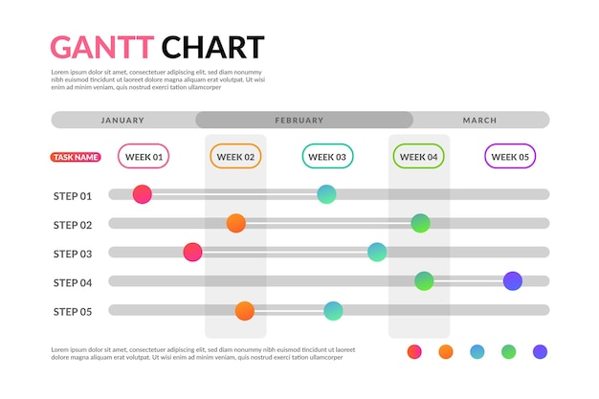
GANTT Chart
Henry Gantt was a social scientist and management consultant who also held a degree in mechanical engineering. He worked in the field of scientific management, developing methods to streamline and increase the productivity of corporations and their workforce. He created the Gantt chart in the 1910s to help supervisors understand the progress of their labour force and to ensure tasks were on schedule.
Source: https://www.freepik.com/free-vector/gradient-template-gantt-chart_10182353.htm#query=gantt%20chart&position=2&from_view=search&track=sph

Slide 19
Time management
Time management is the process of planning and controlling how much time to spend on specific activities. Good time management enables an individual to complete more in a shorter period of time, lowers stress, and leads to career success.
Benefits of time management
The ability to manage your time effectively is important. Good time management leads to improved efficiency and productivity, less stress and more success in life. Here are some benefits of managing time effectively:
Stress relief | More time | More opportunities | Ability to realize goals
A task schedule that is created and followed lowers anxiety. You can see that you are actually moving forward as you cross things off your "to-do" list. This relieves the pressure of worrying about whether you are accomplishing your goals. | Good time management gives you extra time to spend in your daily life. People who can time-manage effectively enjoy having more time to spend on hobbies or other personal pursuits. | A good time management strategy produces more opportunities and less time spent on pointless activities. One of the most important traits that companies look for is effective time management. Any organisation would find it highly advantageous to have the capacity to schedule and prioritise work. | Individuals who practice good time management are able to better achieve goals and objectives, and do so in a shorter length of time.

Slide 20
List of tips for effective time management
After considering the benefits of time management, let’s look at some ways to manage time effectively:
Set goals correctly
Set goals that are achievable and measurable. Use the SMART method when setting goals. In essence, make sure the goals you set are Specific, Measurable, Attainable, Relevant, and Timely.
Prioritize wisely
Prioritize tasks based on importance and urgency. For example, look at your daily tasks and determine which are:
Important and urgent: Do these tasks right away.
Important but not urgent: Decide when to do these tasks.
Urgent but not important: Delegate these tasks if possible.
Not urgent and not important: Set these aside to do later.
Set a time limit to complete a task
Setting time constraints for completing tasks helps you be more focused and efficient. Making the small extra effort to decide on how much time you need to allot for each task can also help you recognize potential problems before they arise. That way you can make plans for dealing with them.

Slide 21
Organize yourself
Utilize your calendar for more long-term time management. Write down the deadlines for projects, or for tasks that are part of completing the overall project. Think about which days might be best to dedicate to specific tasks. For example, you might need to plan a meeting to discuss cash flow on a day when you know the company CFO is available.
Remove non-essential tasks/activities
It is important to remove excess activities or tasks. Determine what is significant and what deserves your time. Removing non-essential tasks/activities frees up more of your time to be spent on genuinely important things.
Plan ahead
Make sure you start every day with a clear idea of what you need to do – what needs to get done THAT DAY. Consider making it a habit to, at the end of each workday, go ahead and write out your “to-do” list for the next workday. That way you can hit the ground running the next morning.
Take a break between tasks
When doing a lot of tasks without a break, it is harder to stay focused and motivated. Allow some downtime between tasks to clear your head and refresh yourself. Consider grabbing a brief nap, going for a short walk, or meditating.

Slide 22
Implications of Poor Time Management
Let’s also consider the consequences of poor time management
You have a loss of control over your life since you are unsure of what the next task is. That could make you feel more stressed out and anxious.
Loss
of
control
Poor time management results in wasted time. For example, by talking to friends on social media while doing an assignment, you are distracting yourself and wasting time.
Poor time management typically makes the quality of your work suffer. For example, having to rush to complete tasks at the last minute usually compromises quality.
Wasted time
Poor quality
of work
Client expectations and your employer's opinion of you are negatively impacted if you are unable to deliver jobs on time. Clients are likely to do business with you elsewhere if they can't trust you to complete tasks on schedule.
Poor efficiency results from a lack of planning and goal-setting. But if you don't prepare in advance, you can find yourself needing to go back and forth or backtrack while working. That results in decreased production and efficiency.
Poor
workflow
Poor
reputation

Slide 23
Team working
“The process of working collaboratively with a group of people in order to achieve a goal.”
It is frequently an essential component of a corporation because it is frequently required that coworkers work well together and give it their all in every situation.
What is teamwork?
To actually accomplish their designated task, the team as a whole must work together. No member can afford to take a back seat and wait for the other to act on his or her behalf. To prevent problems, the team members must be dedicated to both the group and the organisation.
In spite of any interpersonal tension, it signifies that people will make an effort to work together, utilising their unique strengths and offering constructive criticism.

Slide 24
Why is teamwork so important in workplace?
Teamwork is important in every workplace. In-person, virtual, or hybrid environments mixing remote and in-person all thrive on teamwork. Work collaboratively is the only way to achieve a team’s shared goals.
Teamwork is crucial for many reasons than just increased productivity. You feel appreciated for your contributions and have a better working environment when you are a member of a successful team. You get to work on important projects that matter. Work that has significance increases your commitment and well-being in addition to making you feel valued.
Better problem solving
Increased potential for innovation
Happier team members
Enhanced personal growth
Less burnout
More opportunities for growth
Boosted productivity
Smarter risk taking
Fewer mistakes
Expanded creativity
Ten benefits of teamwork

Slide 25
The link between teamwork and relationship
Great teamwork requires great relationships, which in turn require:
Trust which allows people to be open and honest with each other. Establishing trust means do not have to spend time wondering if folks are knifing you in the back. It means being prepared to admit making a mistake, being uncertain, and saying sorry for treating a colleague badly.
Mutual respect where people can have different opinions without being criticised or ridiculed for doing so.
Awareness of self and others: this means having emotional intelligence, taking responsibility for your words and actions, and having empathy with those around you.
Diversity not just accepting diverse views and opinions, but actually welcoming them for what they add to the team.
Open and honest communication which is, of course, a pre-requisite for any good relationship regardless of the selected communication medium and which allows high-quality sharing of information.
Listening: making an effort to truly understand another’s view of the world.
Managing conflict which means focusing on the issue, not the personalities involved in a difference of opinion.

Slide 26
Team building
Team building is a management technique used for improving the efficiency and performance of the workgroups through various activities. It involves a lot of skills, analysis and observation for forming a strong and capable team. The whole sole motive here is to achieve the organization vision and objectives.
The manager responsible for team building must be able to find out the strengths and weaknesses of the team members and create the right mix of people with different skill sets. He must focus on developing strong interpersonal relations and trust among the team members.
The manager must encourage communication and interaction among the team members and also reduce stress with the help of various team-building activities.
Team building is not a one-time act. It is a step by step process which aims at bringing a desirable change in the organization. Teams are usually formed for a particular task or project and are mostly for the short term.

Slide 27
The various steps involved in team building are as follows
Identify the need for team building: the manager has first to analyse the requirement of a team for completing a particular task. It should find out the purpose of the work to be performed, required skills for the job and its complexity before forming a team;
Define objectives and required set of skills: next comes the chalking down of the organizational objectives and the skills needed to fulfil it
Consider team roles: the manager considers the various aspects, i.e. the interactions among the individuals, their roles and responsibilities, strengths and weaknesses, composition and suitability of the possible team members.
Determinate a team building strategy: now the manager has to understand the operational framework well to ensure an effective team building. He/She must himself/herself be assured of the objectives, roles, responsibilities, duration, availability of resources, training, the flow of information, feedback and building trust in the team.
Develop a team of individuals: at this stage, the individuals are collected to form a team together. Each member is made familiar with his roles and responsibilities within the team.

Slide 28
6. Establish and communicate the rules: the rules regarding the reporting of team members, meeting schedules, and decision making within the team are discussed. The individuals are encouraged to ask questions and give their views to develop open and healthy communication in the team.
7.Identify individual’s strengths: various team-building exercise are conducted to bring out the strengths of the individuals. It also helps in familiarizing the team members with each other’s strengths and weakness.
8.Be a part of the team: at this point, the manager need to get involved with the team as a member and not as a boss. Making the individuals realize their importance in the team and treating each member equally is necessary. The team members should see their manager as their team leader, mentor and role model.
9.Monitor performance: next step is checking the productivity and performance of the team as a whole. It involves finding out loopholes and the reason for it. This step is necessary to improve the team’s performance and productivity in the long run.
10. Schedule meetings: one of the most crucial steps is to hold purposeful meetings from time to time to discuss team performance, task-related problems and discuss the future course of action.
11. Dissolve the team: lastly, the manager needs to evaluate the results and reward the individuals on their contribution and achievement. Finally, the team is dispersed on the fulfilment of the objective for which it was formed.

Slide 29
UNIT 4: c) Leading
One of the primary responsibilities of a manager is to ensure the completion of all tasks on time and strict adherence to policies. And for this leadership skills are important. Leadership skill involves:
Creating and sharing a vision of possible achievements by the organization
Communicating with employees and creating good interpersonal relations
Motivating and inspiring team members to perform better.
Leading also ensures that the managers create a positive environment at work. This also helps improve the performance of each employee or group of people, boosts their morale and leads to a productive and innovative team.
The informal and social networks you use to motivate people to take action are examples of leadership. If managers are good leaders, their staff members will be eager to work hard to meet organisational goals.
The behavioural sciences have greatly advanced our knowledge of this managerial function. Studies on job attitudes and personality traits might help managers better understand how to manage their employees. For instance, this research reveals that managers must first comprehend the personalities, values, attitudes, and emotions of their subordinates in order to become effective leaders.

Slide 30
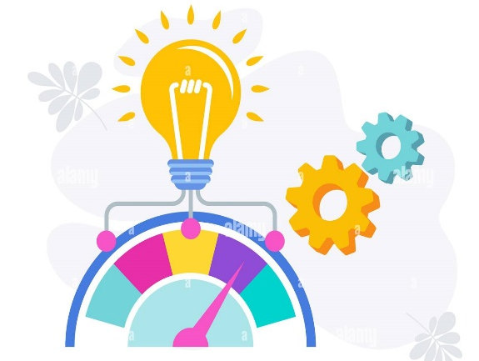
UNIT 5: d) Controlling
Controlling involves ensuring that performance does not deviate from standards. Controlling consists of three steps, which include:
Monitoring ongoing activities
Establishing standards of performance/output;
Comparing actual performance against standards;
Identifying area that need improvement (can be processes, policies or practices);
Taking corrective action when necessary.
Two traditional control techniques are:
budget: A budget audit provides information about where the organization is with respect to what was planned or budgeted for, whereas a performance audit might try to determine whether the figures reported are a reflection of actual performance.
performance audits: an audit involves an examination and verification of records and supporting documents.

Slide 31
Quests
Based on what you have studied in this unit, can you solve the exercises in the following slides?
You will have to make decisions about complicated situations in which you will use the knowledge you have acquired.
Take decisions
Expand your thinking
You will have to open your mind and think as if you were really in that situation, using your best tool: your brain.

Slide 32
Quest 1: Tag Team Game Time
Introduction: What’s this all about?
Task: What’s the activity?
Planning/adaptation exercises in team building
This adaptation exercise requires only a few simple tools, which include large sheets of paper, writing paper, pens and markers. In this exercise, participants are divided into groups of 4-8 people and instructed to share with their group their individual strengths and positive attributes that they feel would lend to their group's success. They have to write down these strengths and attributes on a piece of paper. After the group discussion, each team is given a large sheet of paper, writing paper, markers and a pen.

Slide 33
Quest 1: Tag Team Game Time
Process: What am I going to do?
The groups should then be instructed to create the “final team member” by combining the strengths and positive attributes of each team member into one imaginary person. This 'person' should also be given a name, have a picture drawn of them and have their different attributes labelled. The group should also write a story about this person, highlighting all the things their imaginary person can do with all their amazing attributes.
At the end of the exercise, each group should share their person with the group and read the accompanying story.

Slide 34
Quest 1: Tag Team Game Time
Learning outcomes: What will I learn?
Competence
LifeComp
Self-regulation : awareness and management of emotions, thoughts and behaviour
Empathy: the understanding of another person’s emotions, experiences and values, and the provision of appropriate responses
Collaboration: engagement in group of activity and teamwork acknowledging and respecting others
Competence
EntreComp
Vision: work towards your vision of the future
Mobilising resources: gather and manage the resources you need
Mobilising others: inspire, enthuse, and get others on board
Working with others: team up, collaborate and network

Slide 35
Quest 2: The Prisoner’s Dilemma
Introduction: What’s this all about?
Task: What’s the activity?
Negotiation, Communication, Cooperation
This construct has attracted the interest of thousands of psychologists interested in teamwork and egoism.
In particular, it is possible to apply this paradigm within a stimulating and fast-paced cooperation game.
Team building participants are divided into two subgroups and asked to choose whether or not to confess to a hypothetical crime they are accused of.
The dilemma arises from the fact that the penalty will be divided differently depending on how each of the two subgroups decides to respond.

Slide 36
Quest 2: The Prisoner’s Dilemma
Process: What am I going to do?
The dilemma arises from the fact that the penalty will be divided differently depending on how each of the two subgroups decides to respond. Specifically if one of the two confrontational groups decides to confess and the other does not, there will be a reduced sentence for the former and 5 years imprisonment for the latter; if all teams confess, both will be imprisoned for 4; if no one admits the crime, the joint sentence will be 1 year.

Slide 37
Quest 2: The Prisoner’s Dilemma
Learning outcomes: What will I learn?
Competence
LifeComp
Self-regulation : awareness and management of emotions, thoughts and behaviour
Flexibility: ability to manage transitions and uncertainty, and to face challenges
Empathy: the understanding of another person’s emotions, experiences and values, and the provision of appropriate responses
Collaboration: engagement in group of activity and teamwork acknowledging and respecting others
Critical thinking: assessment of information and arguments to support reasoned conclusions and develop innovative solutions
Competence
EntreComp
Spotting opportunities: use your imagination and abilities to identify opportunities for creating value
Ethical and sustainable thinking: assess the consequences and impact of ideas, opportunities, and actions
Vision: work towards your vision of the future
Working with others: team up, collaborate and network
Coping with uncertainty, ambiguity and risk: make decisions dealing with uncertainty, ambiguity and risk

Slide 38
Self-assessment
Multiple-choice questions: consolidate your learning
Question 1: What are the POLC framework activities?
a) Planning, organizing, leading, controlling
b) Putting, opening, learning, cutting
c) Plugging, ordering, capitalizing, linking
d) No answer is correct
Question 2: With Work Balance Structure it is possible to
a) Assign responsibilities
b) Generate estimates
c) Collect progress data
d) All answers are correct
Question 3: Which of the following activities is not part of management?
a) Planning
b) Organizing
c) Team building
d) Selling

Slide 39
Self-assessment
Multiple-choice questions: consolidate your learning
Question 4: Team building requires…
a) Vaurious steps
b) Specific list of activities
c) Follow one model that applies to all
d) Few activities
Question 5: Why Team working is important?
a) Increased the potential for innovation
b) Smarter risk taking
c) Expanded creativity
d) All answers are correct

Slide 40
Self-assessment
Multiple-choice questions: solutions
Question 1: What are the POLC framework activities?
a) Planning, organizing, leading, controlling
b) Putting, opening, learning, cutting
c) Plugging, ordering, capitalizing, linking
d) No answer is correct
Question 2: With Work Balance Structure it is possible to
a) Assign responsibilities
b) Generate estimates
c) Collect progress data
d) All answers are correct
Question 3: Which of the following activities is not part of management?
a) Planning
b) Organizing
c) Team building
d) Selling

Slide 41
Self-assessment
Multiple-choice questions: solutions
Question 4: Team building requires…
a) Vaurious steps
b) Specific list of activities
c) Follow one model that applies to all
d) Few activities
Question 5: Why Team working is important?
a) Increased the potential for innovation
b) Smarter risk taking
c) Expanded creativity
d) All answers are correct

Slide 42
Summing up
Management
Management is the coordination and administration of tasks to achieve a goal. Such administration activities include setting the organization's strategy and coordinating the efforts of staff to accomplish these objectives through the application of available resources..
Time management
Time management is the process of planning and controlling how much time to spend on specific activities. Good time management enables an individual to complete more in a shorter period of time, lowers stress, and leads to career success.
Team building
Team working
Team building is a management technique used for improving the efficiency and performance of the workgroups through various activities. It involves a lot of skills, analysis and observation for forming a strong and capable team. The whole sole motive here is to achieve the organization vision and objectives.
It means that people will try to cooperate, using their individual skills and providing constructive feedback, despite any personal conflict between individuals

Slide 43
https://eagletraining.co.uk/2020/11/26/importance-of-working-with-others/#:~:text=Well%2C%20working%20with%20others%20is,culture%2C%20rules%2C%20and%20values.
https://www.toppr.com/guides/business-management-and-entrepreneurship/nature-of-management-and-its-process/management-functions
https://corporatefinanceinstitute.com/resources/careers/soft-skills/time-management-list-tips/
Project Management and IT Projects, Guido Nicelli, Fodnazione Politecnico di Milano, Innovazione Digitale
https://slideplayer.it/slide/199543/
https://hbr.org/2020/01/time-management-is-about-more-than-life-hacks?registration=success
https://hbr.org/2016/06/the-secrets-of-great-teamwork
https://slack.com/intl/it-it/blog/collaboration/mastering-time-management-at-work
Resources

Slide 44
Thank you!
Continue your training path at www.projectspecial.eu!

